Slide 1


CSE311: DBMS
Hospital Patient Management System
Presented By:
Nibedita Das
2411860042
Tanim Ahmed
2312597042
Md. Sajidul Islam
2121935642

Slide 2
Database Design & Modeling
ER Diagram identifies all major entities (Patient, Doctor, Staff, Appointment, Billing).
Relational schema converts the ERD into normalized tables for accurate data storage.
Introduction: This project aims to build a Hospital Management System using DBMS principles.
01.
Core Hospital Operations
Manages patient records, doctor information, appointments, admissions, treatments, lab tests, and prescriptions.
Ensures secure, fast, and error-free handling of hospital data.
It organizes and manages key hospital information through a structured relational database to ensure accuracy, efficiency, and smooth workflow.
02.
System Implementation
MySQL used to create and store relational data.
PHP and HTML used to build a user-friendly interface for interacting with the database.
03.

Slide 3
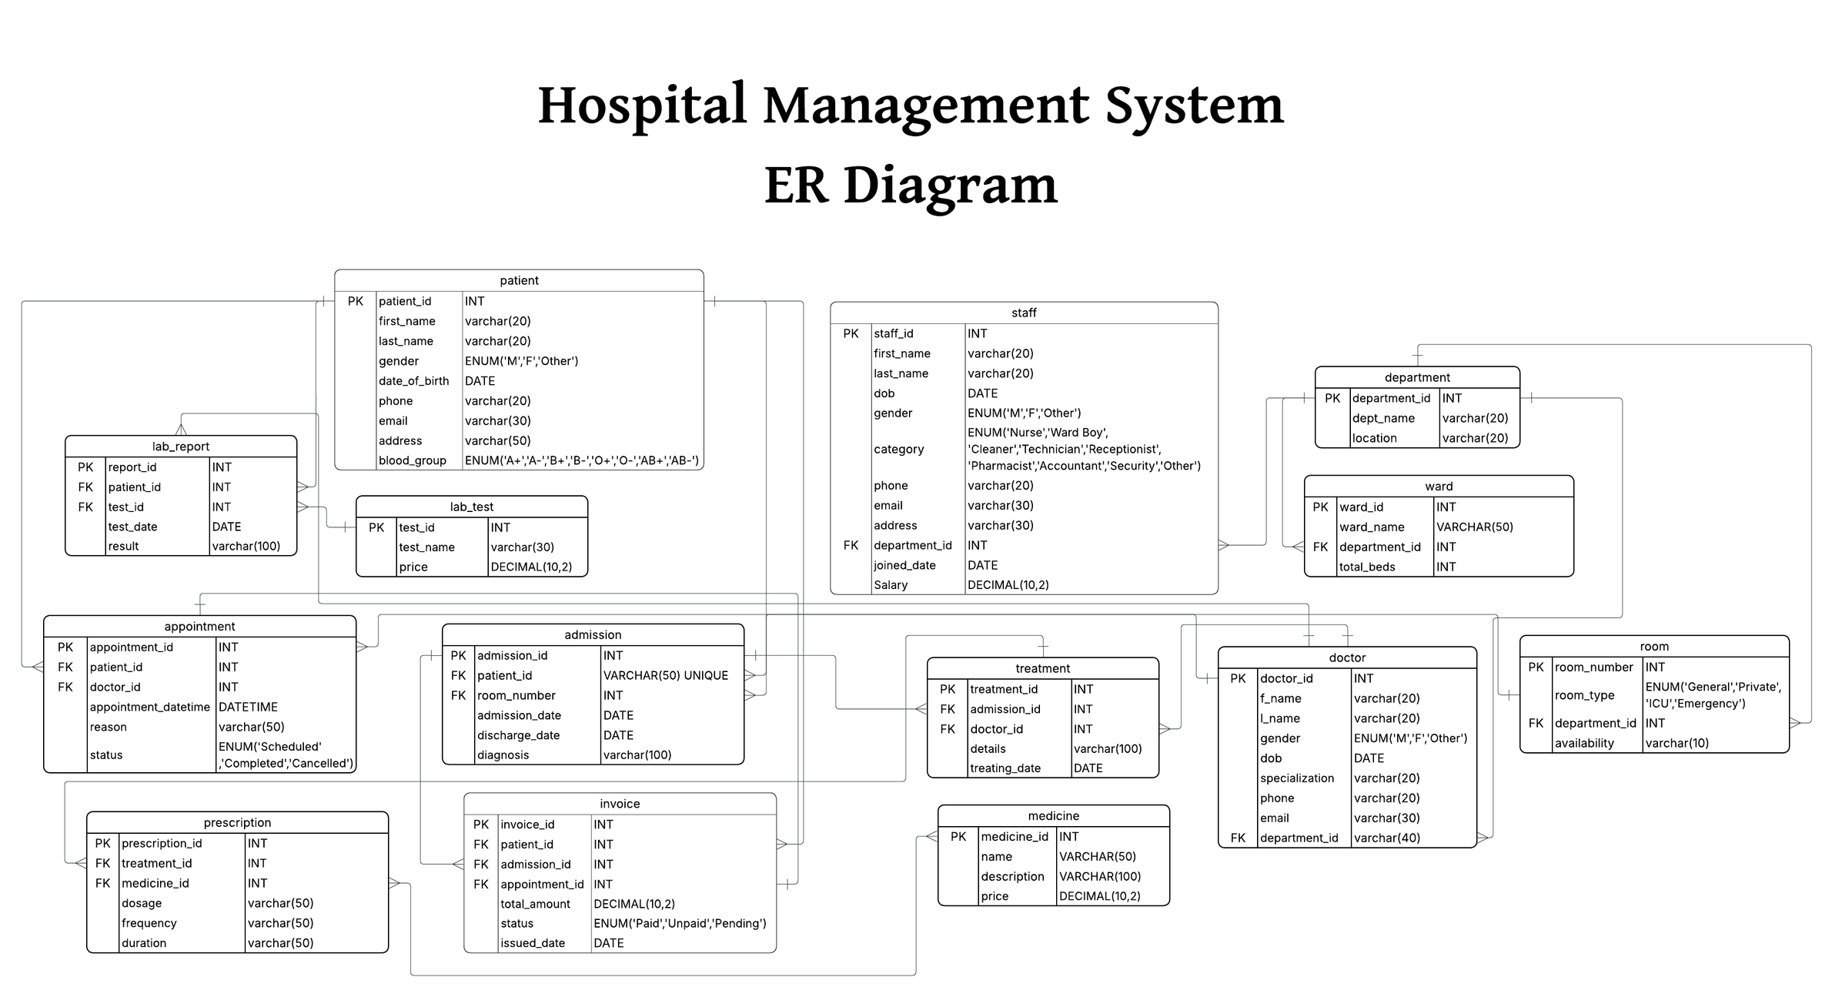

Slide 4
Relational Schema
01. Patient (patient_id PK, first_name, last_name, gender, date_of_birth,
phone, email, address, blood_group)
02. Staff (staff_id PK, first_name, last_name, dob, gender, category, phone, email, address, department_id FK, joined_date, salary)
03. Department (department_id PK, dept_name, location)
04. Ward (ward_id PK, ward_name, department_id FK, total_beds)

Slide 5
05. Room (room_number PK, room_type, department_id FK, availability)
06. Doctor (doctor_id PK, f_name, l_name, gender, dob, specialization,
phone, email, department_id FK)
07. Lab_Test (test_id PK, test_name, price)
08. Lab_Report (report_id PK, patient_id FK, test_id FK, test_date, result)
09. Appointment (appointment_id PK, patient_id FK, doctor_id FK,
appointment_datetime, reason, status)

Slide 6
10. Admission (admission_id PK, patient_id FK, room_number FK,
admission_date, discharge_date, diagnosis)
11. Treatment (treatment_id PK, admission_id FK, doctor_id FK,
details, treating_date)
12. Medicine (medicine_id PK, name, description, price)
13. Prescription (prescription_id PK, treatment_id FK, medicine_id FK,
dosage, frequency, duration)
14. Invoice (invoice_id PK, patient_id FK, admission_id FK, appointment_id FK, total_amount, status, issued_date)

Slide 7
Normalization
PATIENT TABLE – Normalization
Steps
Patient(patient_id, first_name, last_name, dob, gender, phone, address)
1NF
All values are atomic, no repeating groups.
→ Already in 1NF.
2NF
Primary key = patient_id (single attribute)
→ No partial dependency.
→ Already 2NF.
3NF
No transitive dependencies.
→ Already 3NF.
BCNF
Every determinant is a candidate key.
→ patient_id determines all.
→ BCNF satisfied.

Slide 8
Normalization
DOCTOR TABLE – Normalization
Steps
Doctor(doctor_id, first_name, last_name, phone, department_id, specialization)
1NF
All values atomic.
2NF
PK = doctor_id
→ no partial dependencies.
3NF
No attribute determines another non-key attribute.
No transitive dependency.
BCNF
doctor_id
→ all attributes
No other functional dependencies.
→ BCNF.

Slide 9
Normalization
ADMISSION TABLE – Normalization
Steps
Admission(admission_id, patient_id, room_id, admission_date, discharge_date, diagnosis)
1NF
All atomic.
2NF
PK = admission_id → all attributes dependent.No partial dependency.
3NF
diagnosis depends on admission, not patient.
No transitive dependency.
BCNF
admission_id is the only determinant.
→ BCNF.

Slide 10
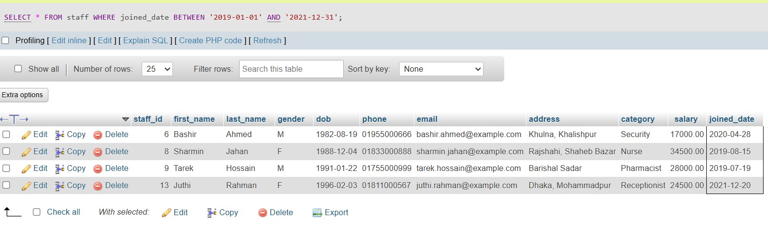
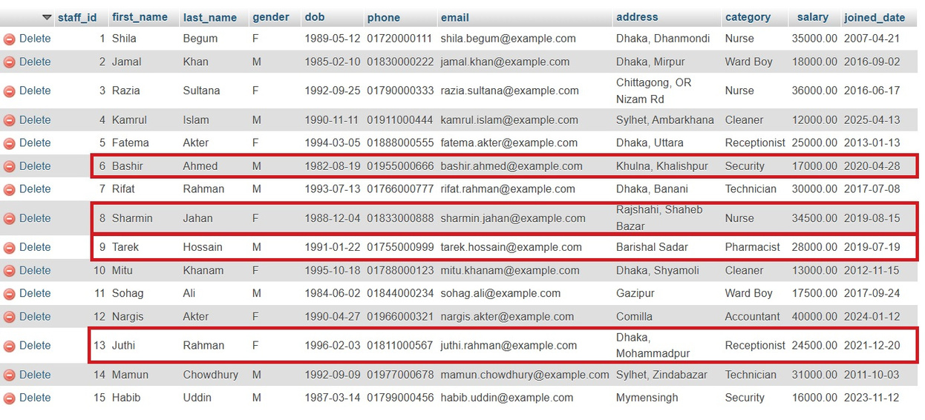
Sample: SQL queries
List all staff members who joined between the years 2019 and 2021 (inclusive)

Slide 11
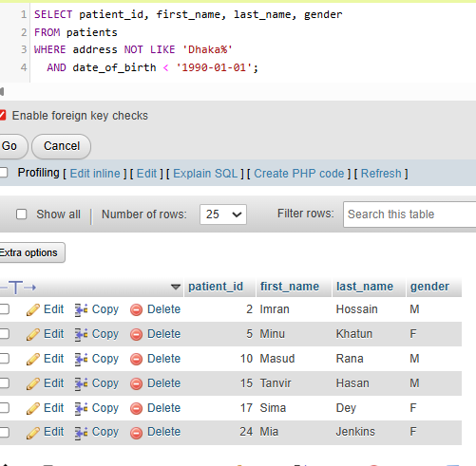
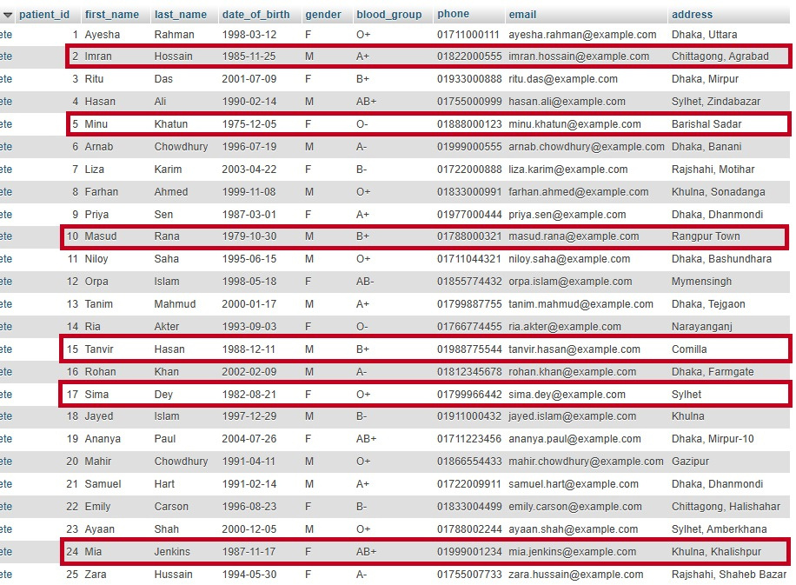
Sample: SQL queries
List all patients whose address is outside Dhaka and whose date of birth is before 1 January 1990.

Slide 12


Slide 13
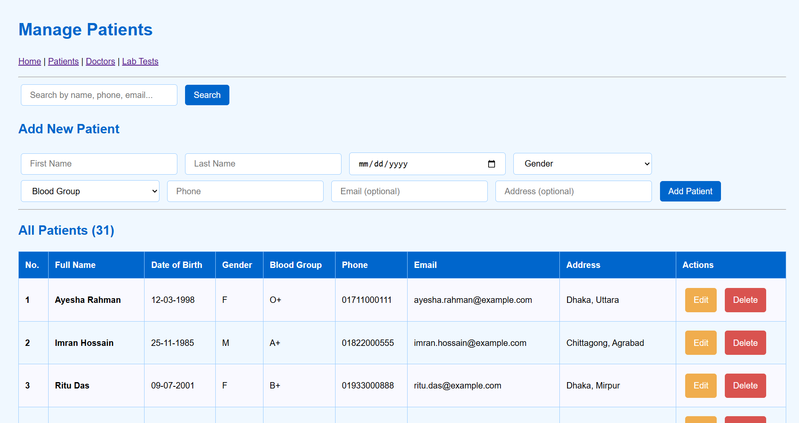

Slide 14
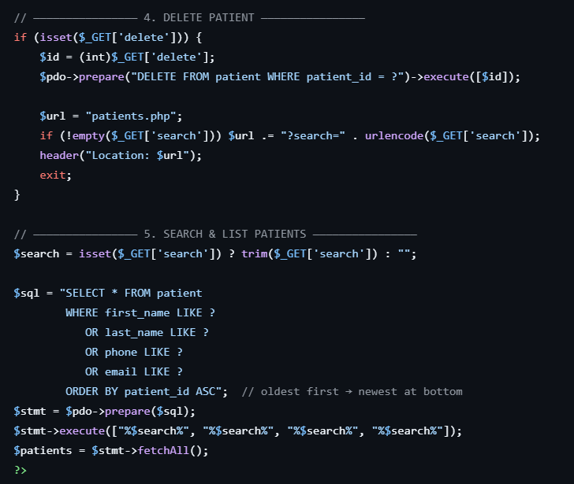

Slide 15
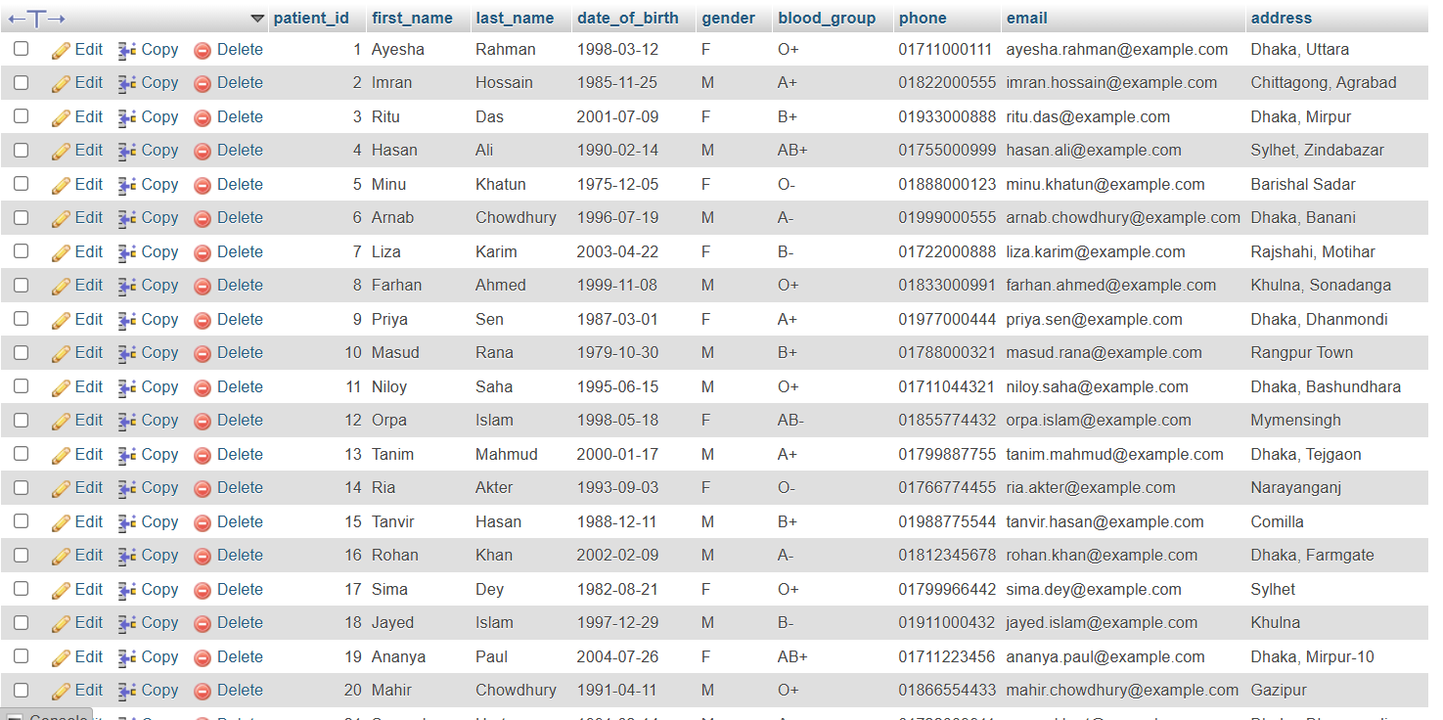

Slide 16

Thank you very much!

